Slide 1
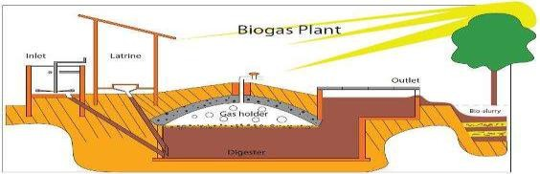
L-T-P-C
3-0-0-3
Renewable Energy Engineering
Module - IV

Slide 2
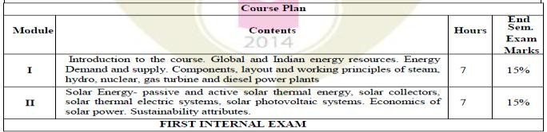
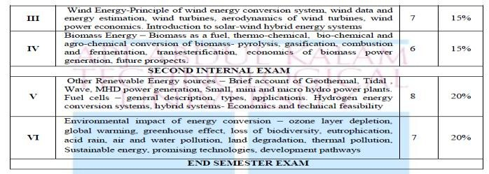
4

Slide 3
After successful completion of this course, students will be able to
Course Outcomes
Sl. NO | DESCRIPTION | PO MAPPING
1 | Discuss and compare the layout and working principles of steam, hydro, nuclear, gas turbine and diesel power plants. | PO1
2 | Describe the use of solar energy and the various components used in the energy production. | PO1
3 | Appreciate the need of wind energy and the various components used in energy generation and know the classifications. | PO1
4 | Acquire knowledge about the concept of power generation from biomass energy resources and their future prospects and economics. | PO1
5 | Describe the principles and applications of power generation from various sources and Hydrogen energy conversion systems. | PO1
6 | Understand energy scenario and the environmental effects of energy conversion and become aware of different renewable energy sources and choose sustainable energy for future. | PO1
3

Slide 4
Biomass to Energy
The Sun is the direct or indirect source of nearly all our
energy on earth.
Energy can change from one form to another.
Plants capture solar energy through photosynthesis
to make food, a type of chemical energy.
Biomass is a name for plant and animal waste used as an energy source or fuel.
Biofuels are liquid and gas fuels used for transportation, heat and electricity.
6

Slide 5
Biomass Energy
Energy obtained from organic matter derived from biological organisms (plants and animals).
Classified in to 2 categories
Biomass from cultivated fields, crops and forests.
Biomass from municipal waste, animal dung, agricultural waste and fisheries waste.
Biomass energy may be transformed by chemical or biological processes to produce biofuels like methane, producer gas, ethanol and charcoal etc.
7

Slide 6
Useful forms of biomass
b. Biodiesel –Biodiesel can be produced from different feedstocks, such as oil feedstock (eg. rapeseed, soybean oils, jatropha, palm oil, hemp, algae, canola, flax, and mustard), animal fats, and/or waste vegetable oil. Recycled restaurant oil is also one of the most important sources of biodiesel. The most common production method for converting vegetable oil and animal fats into bio-diesel is transesterification. The purpose of the transesterification process is to lower the viscosity of the raw oil to allow proper atomization of the fuel. Biodiesel can be used to power engines (diesel engines), either alone, as pure biodiesel or mixed with petroleum diesel in various ratios. Compared to petroleum diesel, biodiesel is biodegradable and non-toxic.
10

Slide 7
Useful forms of biomass
Bio-fuel – The two most common types of bio-fuels are ethanol and biodiesel. These fuels are usually blended with the petroleum fuels such as petrol and diesel fuel, but they can also be used on their own. Ethanol and biodiesel are usually more expensive than the fossil fuels but they are cleaner fuels with less pollution.
Ethanol (ethyl alcohol) – Methanol, ethanol, propanol and butanol can be used as an alternative fuel. Ethanol is the most widely used alcohol, primarily as a fuel for transportation or as a fuel additive because it can be produced in large quantities from fermenting plant-based material. Ethanol can be combined with petrol in any concentration up to pure ethanol. Bio-ethanol can be produced from a variety of feedstocks, including sugarcane, corn, sugar beet, cassava, sweet sorghum, sunflower, potatoes, hemp, or cotton seeds, or derived from cellulose waste. The starches and the sugars in these plants are fermented, and the ethanol is then obtained by distillation. Ethanol is a clean-burning, particulate-free fuel source. When burnt with oxygen, the end product is carbon dioxide and water. But, ethanol has a lower heat of combustion.
9

Slide 8
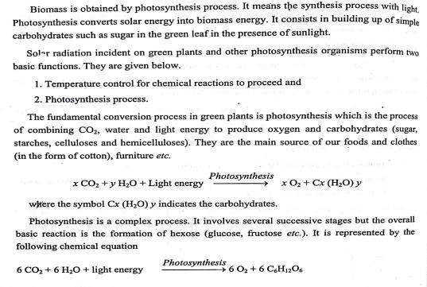
Photosynthesis Process
12

Slide 9
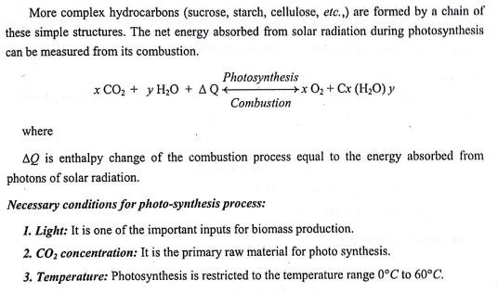
Photosynthesis Process
13

Slide 10


Useful forms of biomass
The energy available from various biomass resources are listed in the
table below.
Sl. No. | Biomass source | Bio-fuel produced | Conversion technology | Available energy (MJ/kg)
1. | Wood chips, saw mill dust, forest residues. | Direct heat | Incineration | 16 – 20
2. | Wood chips, saw mill dust, forest residues | Gas, Oil, Char | Pyrolysis | 40 40 20
3. | Sugarcane crops | Ethanol | Fermentation | 26
4. | Animal waste | Biogas | Anaerobic digestion | 4 – 8
5. | Municipal sewage | Biogas | Anaerobic digestion | 2 – 4
6. | Vegetable oil sewage | Biodiesel | Transesterification | 38
16

Slide 11
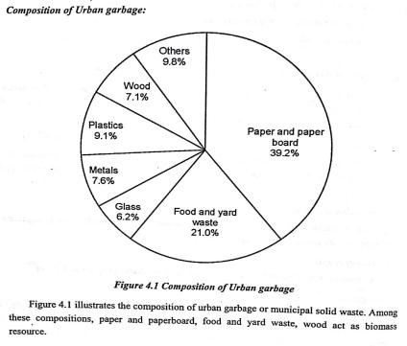
Composition of urban garbage
15

Slide 12
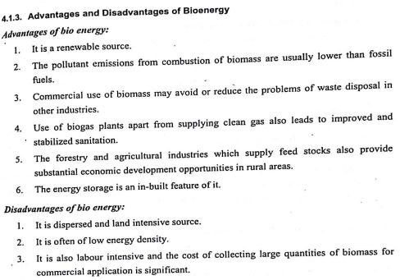
Biomass – Merits and demerits
18

Slide 13
Advantages of biomass energy
Plants ensure a continuous supply of energy due to their continuous growth and hence it is a renewable source of energy.
The cost of obtaining bio-energy through energy-plantations is less than the cost of obtaining energy from fossil fuels.
The production of biogas (particularly from animal wastes) has additional value in intensive agricultural systems as a method of avoiding pollution.
The forestry and agricultural industries that supply feed stocks also provide substantial economic development opportunities in rural areas.
The pollutant emissions from combustion of biomass are usually lower than those from fossil fuels.
Commercial use of biomass may avoid or reduce the problems of waste disposal in other industries, particularly municipal solid waste in urban centers.
Varying capacity can be installed; any capacity can be operated, even at lower loads, with no seasonality involved.
Disadvantages of biomass energy
Biomass source is often of low energy density.
Methane gases produced using biomass is harmful to the Earth’s ozone layer.
Capacity is determined by availability of biomass and not suitable for varying loads.
It is not feasible to set up at all locations.
Transportation of biogas through pipe over long distances is difficult.
Crops which are used to produce biomass energy are seasonal.
A large number of trees are being cut down in order to produce power. Continuing to
operate on such a large scale will eventually result in the deforestation.
19

Slide 14
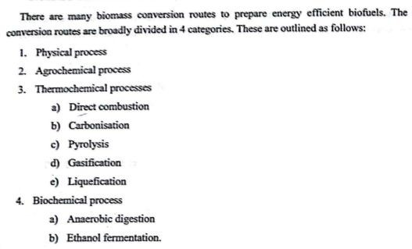
Biomass Conversion Processes
22

Slide 15
Biomass conversion technologies
Combustion
Electric power
Pyrolysis
Char, oil, biogas
Thermo-chemical conversion
Gasification
Producer gas
Liquefaction
Liquid fuel
Anaerobic digestion
Methane
Biomass
Bio-chemical conversion
Aerobic digestion
Compost
Fermentation
Ethanol
Agro-chemical conversion
Transesterification
Bio-diesel
Biomass conversion
Biomass can be converted into different forms of energy by using various processes.
For the production of energy from biomass, the term feedstock is used to refer to whatever type of organic material (wood, plants, animal residues, etc.) which can be used to produce a form of energy.
Biomass can be converted into three main products, viz., power or heat generation, transportation fuels (such as ethanol) and chemical
feedstock (such as methane).
21

Slide 16
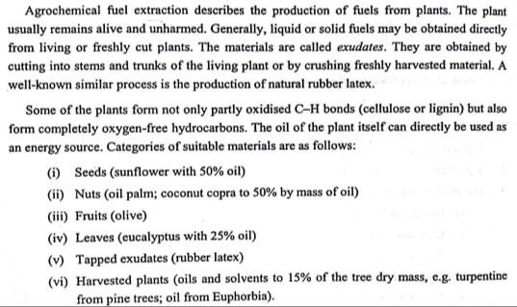
Agrochemical Conversion of
Biomass
24

Slide 17
Agro-chemical conversion of biomass
Agro-chemical conversion can take two pathways.
Straight Vegetable Oil (SVO)/Pure Plant Oil (PPO)
Transesterification

Slide 18
Transesterification
Transesterification is the reaction of triglycerides (fat/oil) in the presence of catalyst (sodium hydroxide or sodium methoxide) and alcohol producing biodiesel and glycerin.
Biomass feedstock
Oil extraction
Triglyceride + Methanol
NaOH
Fatty acid methyl ester + Glycerin
(Catalyst)
Transesterification
Transesterification
The heavier, co-product, glycerol settles out and may be used as it is or it may be purified for use in other industries, eg. the pharmaceutical, cosmetics, etc.
Separation of biodiesel
from glycerin
The key factors regulating transesterification are temperature (>240 °C), pressure (>5 bars), reaction time and mixing.
Biodiesel
Transesterification process

Slide 19
Transesterification
Biodiesel (fatty acid methyl esters) can be produced from vegetable
oil, animal oil/fats, and waste cooking oil.
Biodiesel has substantially different properties than SVO and results in better engine performance. In particular, biodiesel has a lower boiling point and viscosity than SVO.
Biodiesel is biodegradable, non-toxic and essentially free from sulphur. Biodiesel can be used in pure form or may be blended with petroleum diesel at any concentration for use in most modern diesel engines.
Biodiesel can be produced from a variety of feedstock, such as oil feedstock (rapeseed, soybean oils, jatropha, palm oil, hemp, algae, canola, flax and mustard), animal fats, and/or waste vegetable oil.
Biodiesel produces no net output of carbon in the form of carbon dioxide (CO₂).
Two methods that are commonly applied for biodiesel synthesis are
transesterification and esterification processes.

Slide 20
Thermo-chemical conversion of biomass
Thermo-chemical conversion of biomass uses heat and catalysts in order to convert biomass into thermal energy, gas or liquid which can be used either directly for the generation of electric power and heat, or it can be further processed into fuel and chemicals.
Thermo-chemical conversion of biomass can take place by the pathways categorized as direct combustion, pyrolysis, gasification, and liquefaction.
By using these processes, the biomass can be converted into either a solid fuel, liquid fuel or gaseous fuel which can be further used for the generation of electricity, heat, chemicals and fuels.
30

Slide 21

Direct combustion of biomass
Exhaust
Steam Turbine
Furnace/Boiler
 | Storage |  | Pretreatment
Electricity
Generator
Biomass
Ash Co
Direct combustion/Steam turbine system
In direct combustion, biomass is burned in presence of excess oxygen.
The products from the combustion of biomass are heat, light, and byproducts at temperatures around 800°C–1000°C. This is a result of the exothermic reaction between the carbon and oxygen in the fuel that releases a significant amount of heat, while forming water and CO₂.
Energy produced by combustion of biomass can be utilized in the generation of electricity, or used directly for stoves, boilers, district heating (heat and/or cooling to multiple buildings from a central source), etc.
31
 | Condenser
ndensate

Slide 22

Direct combustion of biomass
In fluidised bed combustion of biomass, the
Flue gas
biomass is fed into a bed of hot inert particles, such as sand.
The biomass-particle mix is suspended by an upward flow of combustion air within the bed.
At sufficient flow rates, the bed acts as a fluid resulting in rapid mixing of particles. The operating temperature is normally controlled within the range 750°C – 950°C.
Fluidized bed
Biomass
The rapid mixing and turbulence within the Bottom bed
fluidized bed enables efficient combustion to
be achieved with high heat releases.
As a result of better heat transfer in FBC,
the unit size and hence the capital costs are
Ash
Combustion air
reduced. Fluidised bed combustion
34

Slide 23
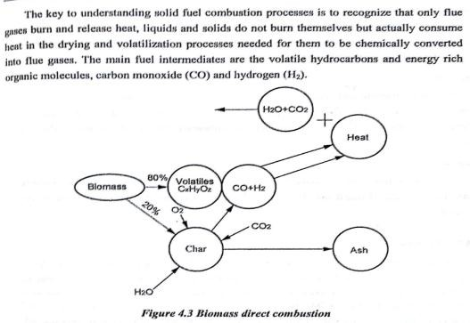
Direct combustion of biomass
33

Slide 24
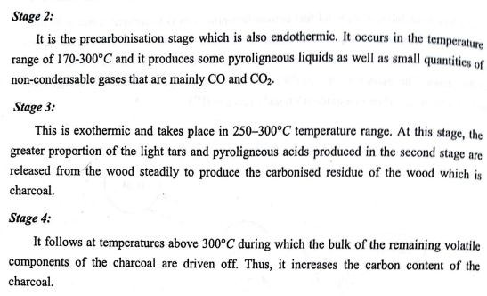
Carbonisation
36

Slide 25

Pyrolysis
Charcoal
Biomass
Bio-oil
Pyrolysis
(Heating in inert atmosphere)
Pyrolysis
Biogas
The basic thermo-chemical process to convert biomass into a more valuable and/or convenient product is known as pyrolysis.
The products of pyrolysis are three types of fuels, usually, a gas mixture (H₂, CO, CO₂, CH₄ and N₂, an oil-like liquid (bio-oil- a water-soluble phase including acetic acid, acetone, methanol and a non-aqueous phase including oil and tar) and a nearly pure carbon char.
The distribution of these products depends upon the type of feedstock, the temperature and pressure during the process and its duration and the heating rate.
37

Slide 26
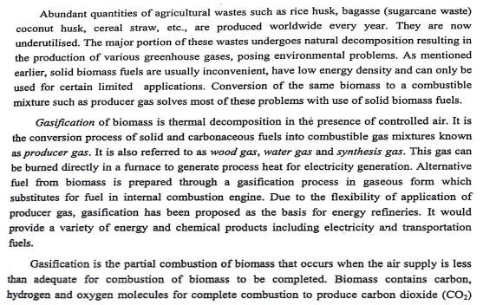
Gasification
40

Slide 27
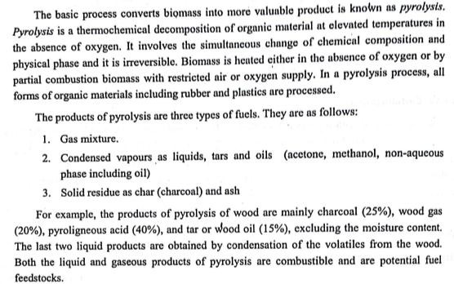
Pyrolysis
39

Slide 28
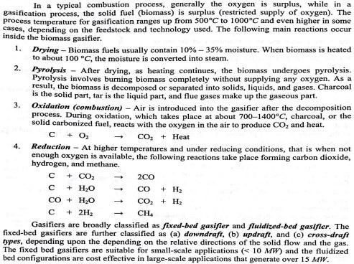
Gasification
42

Slide 29
Biomass gasification-classification
Gasifiers are broadly classified as : -
Fixed-bed gasifier – The fixed-bed gasifiers are further classified as, depending upon the depending on the relative directions of the solid flow and the gas.
Downdraft
Updraft, and
Cross-draft
The fixed bed gasifiers are suitable for small-scale applications (< 10
MW).
Fluidized-bed gasifier – The fluidized bed configurations are cost effective in large-scale applications that generate over 15 MW.

Slide 30
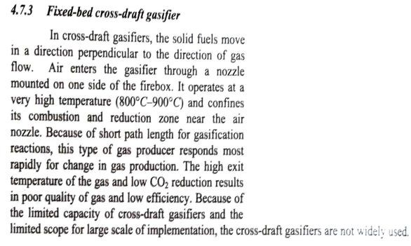


Fixed Bed cross draft gasifier
Biomass feed
Drying zone
Pyrolysis zone
Combustion zone Producer gas
Reduction zone
Air
Fixed-bed cross-draft gasifier
46

Slide 31
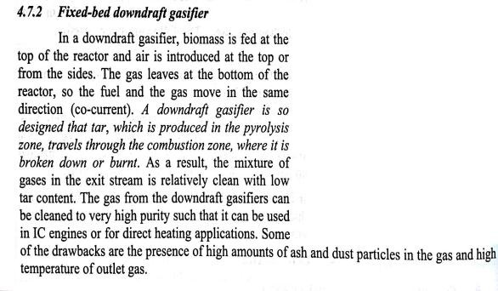




Fixed Bed downdraft gasifier
Biomass feed
Drying zone
Pyrolysis zone
Combustion zone
Air
Air Reduction zone Producer gas
Ash
Fixed-bed downdraft gasifier
45

Slide 32
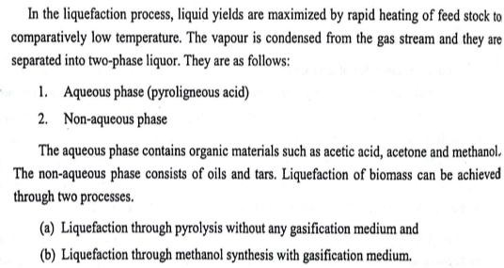
Liquefaction
48

Slide 33
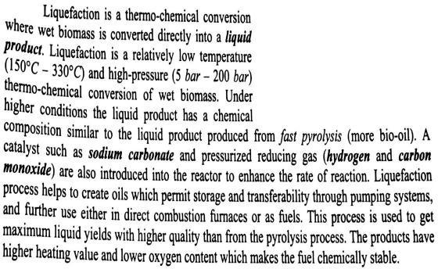

H2 + CO NaCO3
Biomass
Liquefaction
Pre-treated slurry inlet
Liquefaction reactor
49

Slide 34
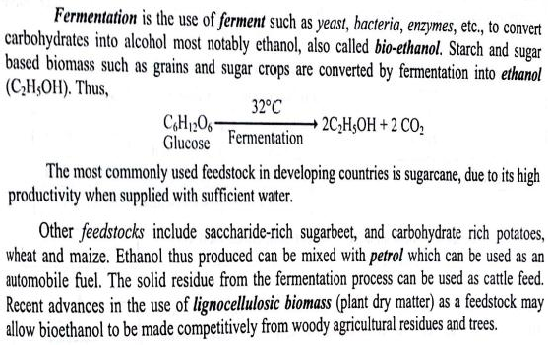
Fermentation
52

Slide 35
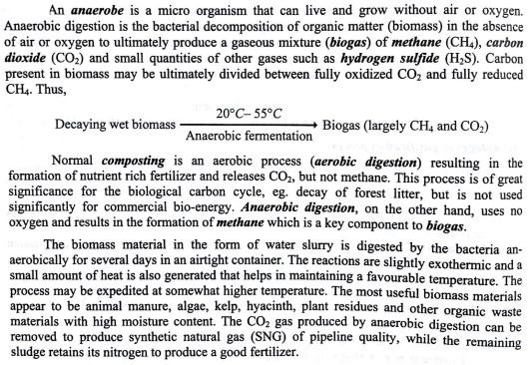
Anaerobic digestion
51

Slide 36
Biogas plant
Biogas is a flammable fuel gas with 60% CH₄ and rest CO₂
A biogas plant converts wet biomass into biogas by the process of anaerobic fermentation.
The anaerobe bacteria carries out digestion of biomass without oxygen and produces methane and carbon dioxide.
There are 2 types of biogas plant designs
Fixed dome type
Floating drum type
54

Slide 37
Biogas plant
Biogas is a flammable fuel gas with 60% CH₄ and rest CO₂.
The gas can be upgraded by removal of CO₂ and the gas with high
heating value can be used in I.C. engine.
The main applications of biogas are (i) cooking. (ii) domestic lighting and heating and (iii) I.C. engines.
Biogas plant (biogas digester) converts wet biomass into biogas (methane) by the process of anaerobic fermentation.
The bacteria called anaerobe carries out digestion of biomass without oxygen and produces methane (CH₄) and carbondioxide (CO₂).
There are two major types of biogas designs promoted in India, viz., floating drum and fixed dome type.

Slide 38
Floating drum type digester
Slurry inlet tank
Gas
Sludge
Gound level
Central guide
Outlet tank Outlet pipe
Inlet pipe
Digester
Partition wall
Floating dome type digester
58

Slide 39
Biogas plant- fixed dome type
The pressure inside the digester increases as the biogas is liberated. The biogas gets collected in the upper portion of the digester in a dome shaped cavity.
The outlet pipe is provided at the top of the fixed dome.
The fixed dome type digester can be fed on daily basis with small quantities of the slurry.
The excess slurry in the digester gets accommodated in the
displacement chamber.
In the fixed dome type digester biogas plant (constant volume), the digester and gas-collector (gas dome) are enclosed in the same chamber.
The digester is conveniently built at or below ground level in comparatively cooler zone.
The slurry (cattle dung and water in the ration 1:1 for gobar gasplant) is fed from the inlet.

Slide 40
Comparing fixed dome and floating drum biogas plant
Fixed dome | Floating drum
Digester and gas holder can be masonry or concrete structure. | Digester, masonry, gas holder can be mild steel or fiberglass.
Requires high masonry skills. | Low masonry skill is required.
Low reliability due to high construction failure. | High reliability.
Variable gas pressure. | Constant gas pressure.
Digester could be inside the ground. | Requires space above ground for three tanks; inlet, digester, outlet.

Slide 41
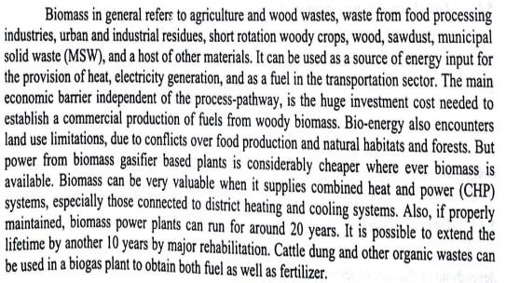
Economics of biomass power
generation
61

